Slide 1

Analysing the impact of influencers: luxury handbags, using sentiment analysis

Slide 2

What is this dissertation about ?
Analysing the impact of influencers, particularly 4 categories based on the follower's count. The study investigates the impact of social media influencers using sentiment analysis. The rise of influencers has transformed digital marketing, and we aim to understand how their content affects people's sentiments and emotions.

Slide 3
Brief about influencers
Nano influencer – A nano-influencer is an individual on social media who has a relatively small but highly engaged and loyal following. Typically, they have followers < 10k
Micro influencer- A micro-influencer is an individual on social media who has a moderately sized and engaged following, typically ranging from 10k to 100k followers.
Macro influencer- A macro-influencer is an individual on social media who has a large and often extensive following, typically ranging from (100k – 1M)
Mega influencer- A mega influencer is an individual on social media who has an exceptionally large and influential following, typically they have millions of followers

Slide 4
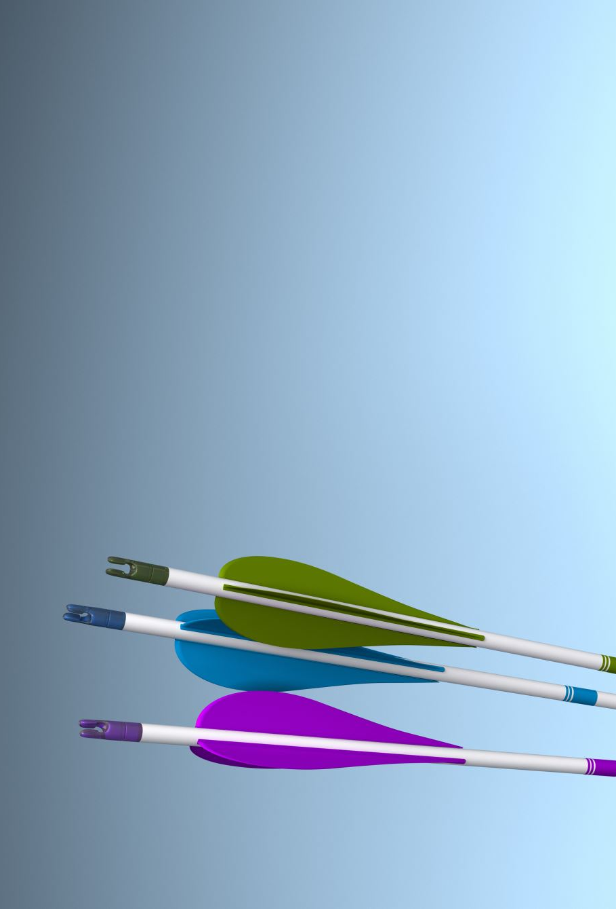
Aim
The aim of this study is to examine, the link between influencers and their followers, that can help brand to pick right influencer for influencer marketing.

Slide 5

Objectives
Data collection
Categorizing influencers
Conducting sentiment analysis
Evaluating model

Slide 6
Process
Problem statement
Data collection
Data preparation
Exploratory data analysis
Applying models
Interpreting findings

Slide 7
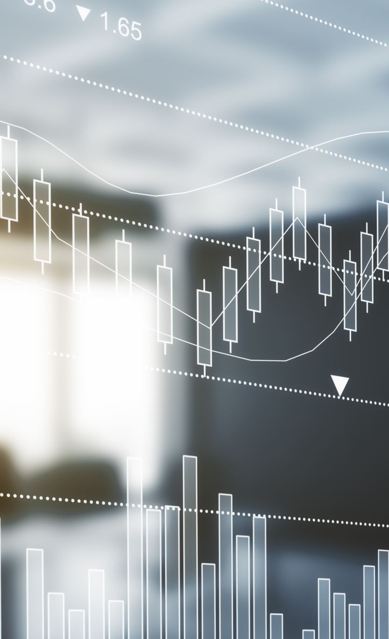
Sentiment analysis model
There are two lexicon-based sentiment analysis models:
1- VADER Sentiment Analysis
2- Text Blob Sentiment Analysis.
Additionally, there is a deep learning-based sentiment analysis model
1- BERT.

Slide 8
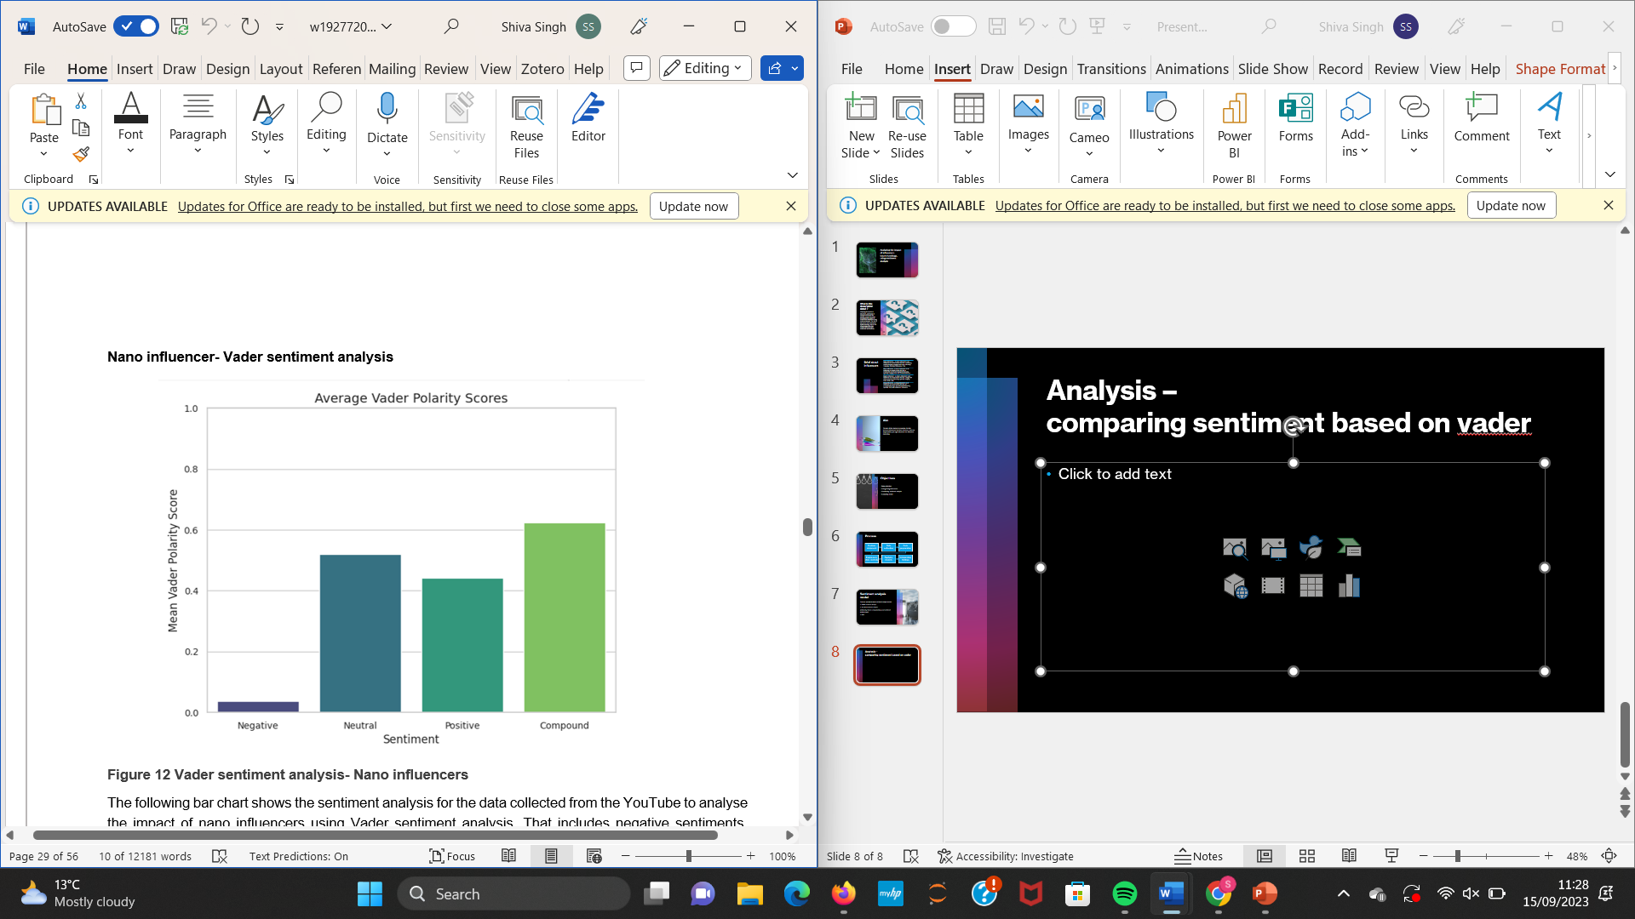
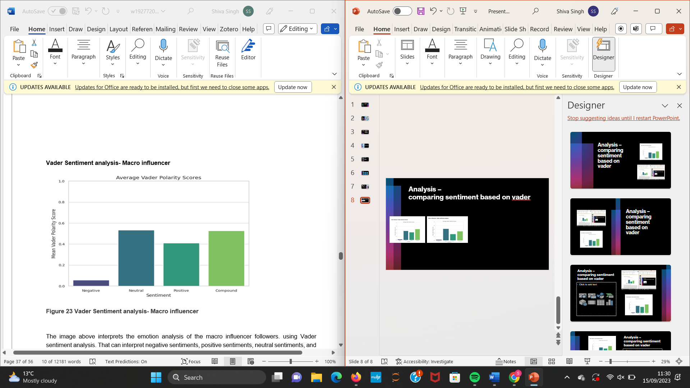
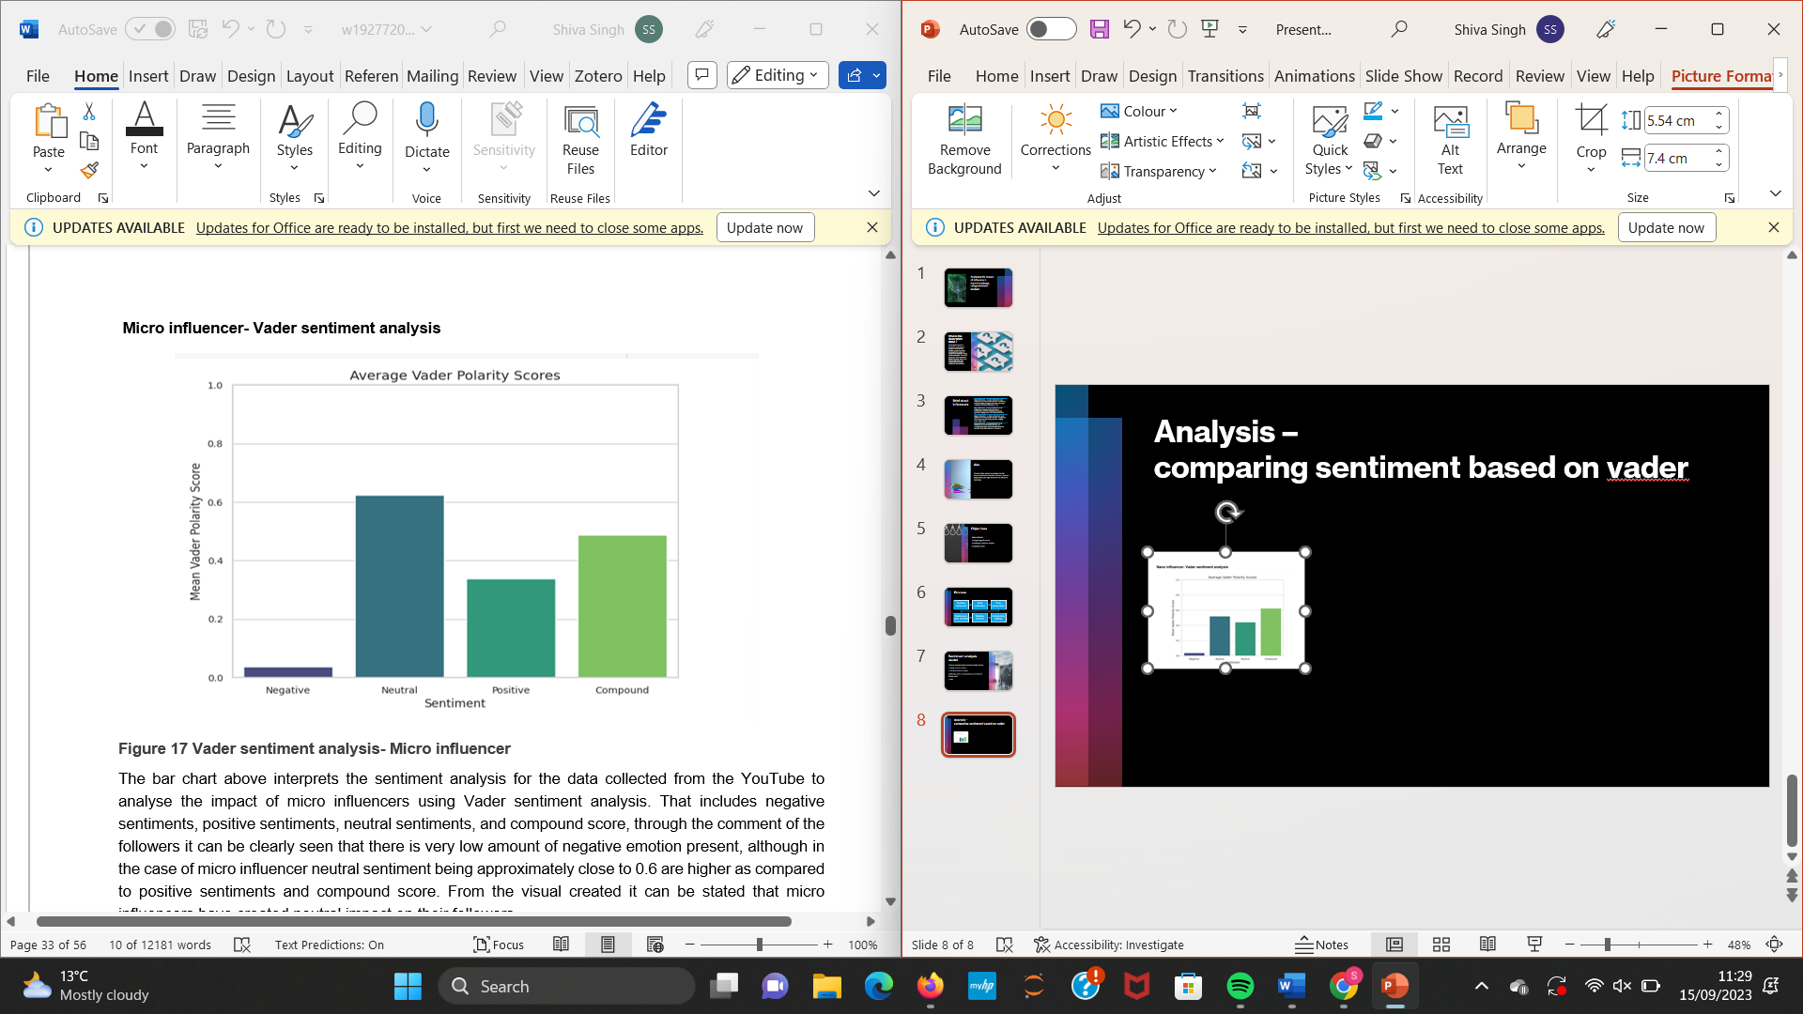
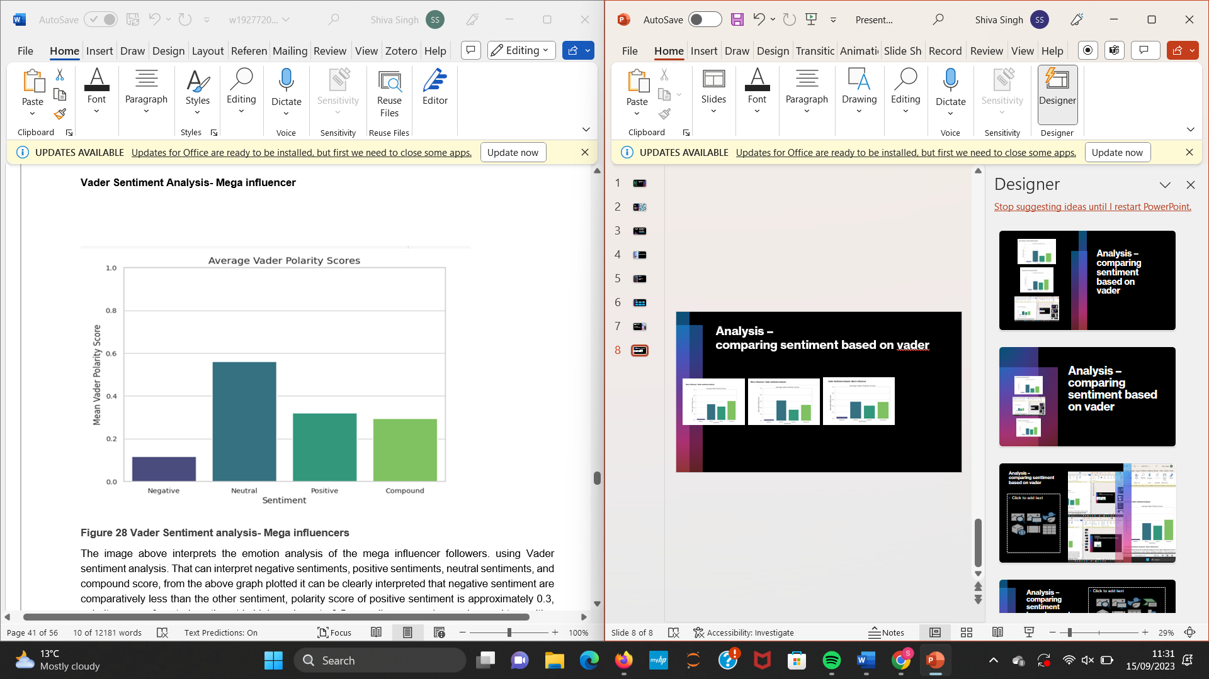
Analysis – comparing sentiment based on vader model

Slide 9
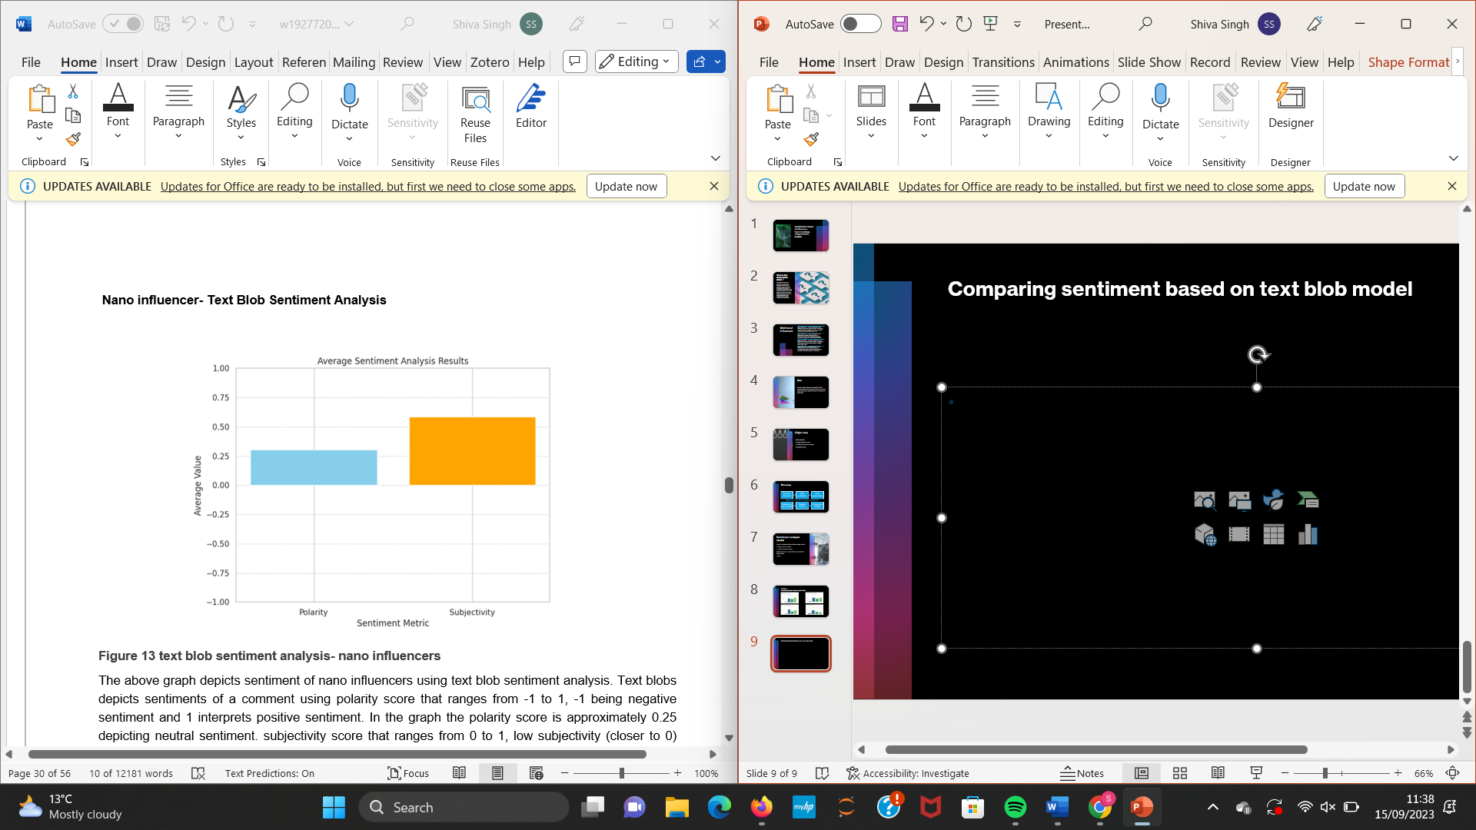
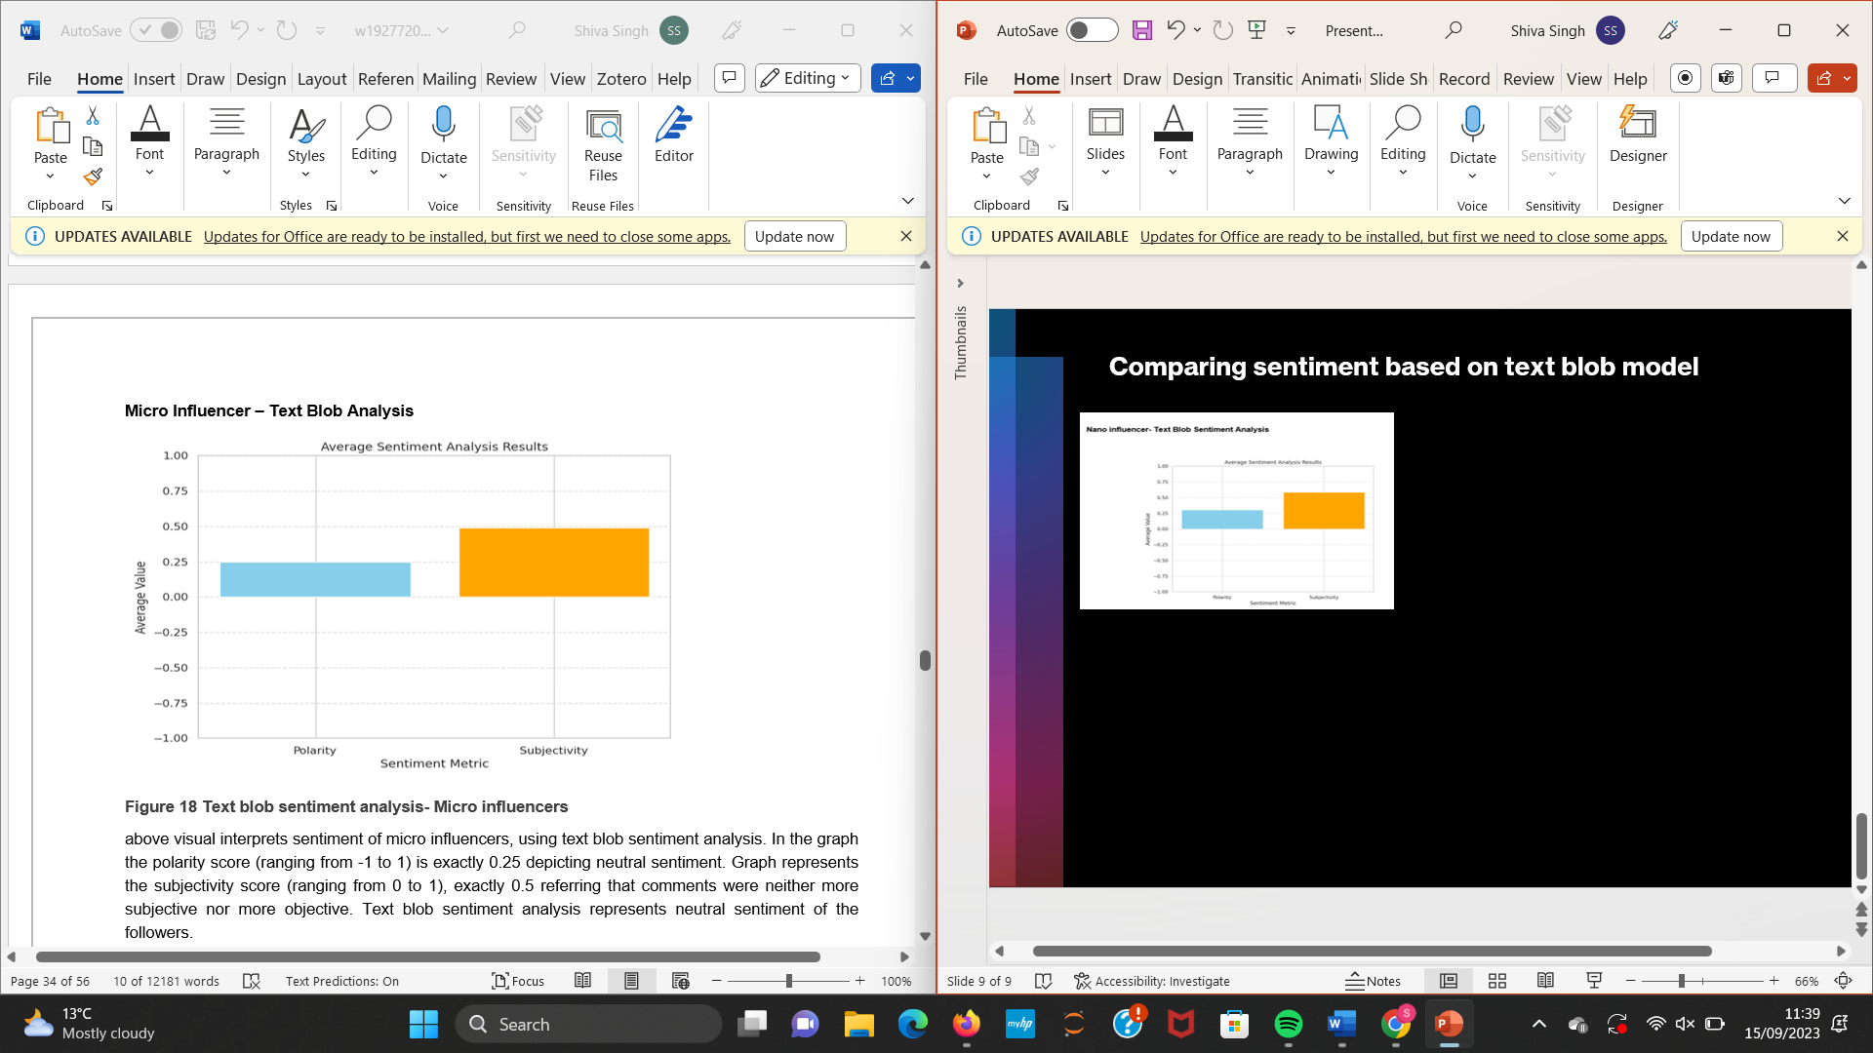
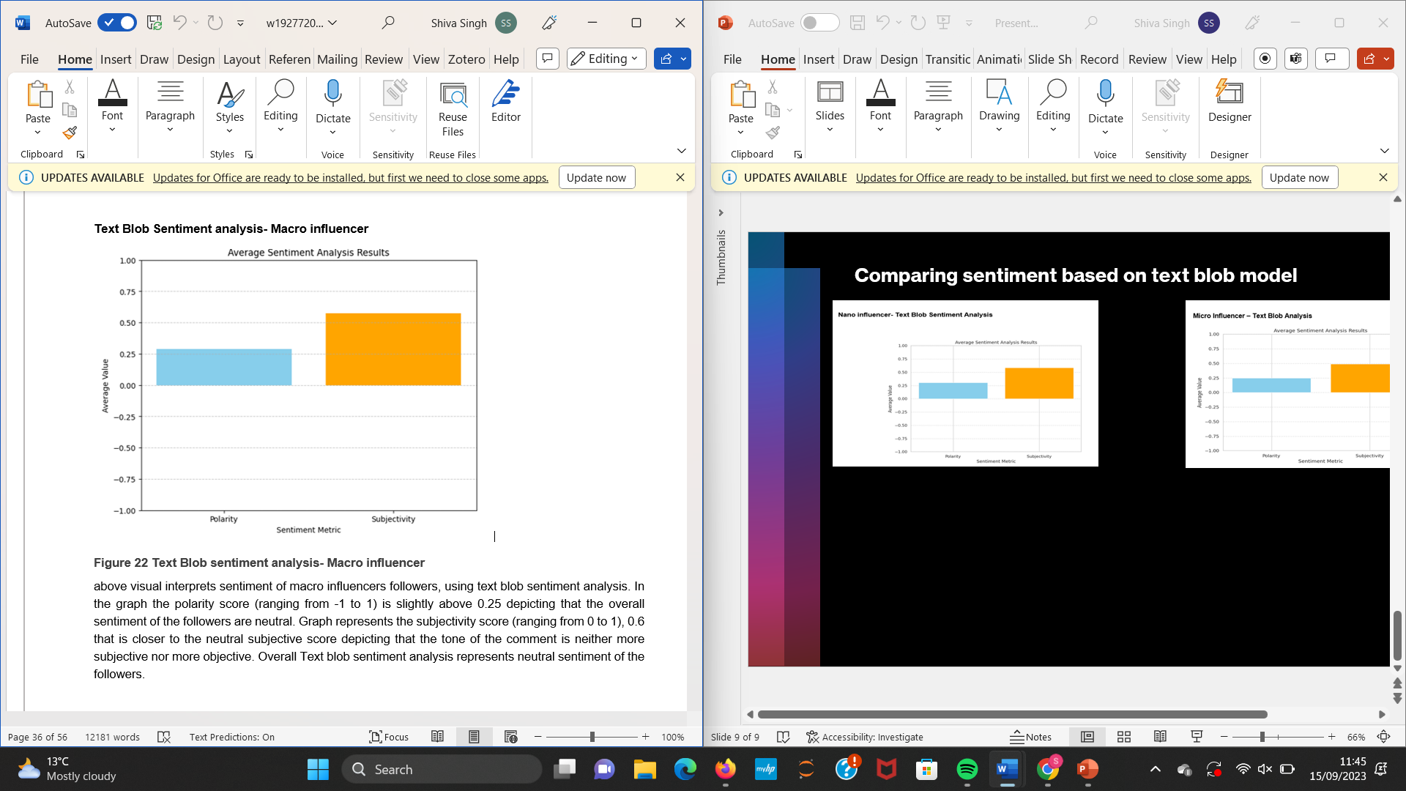
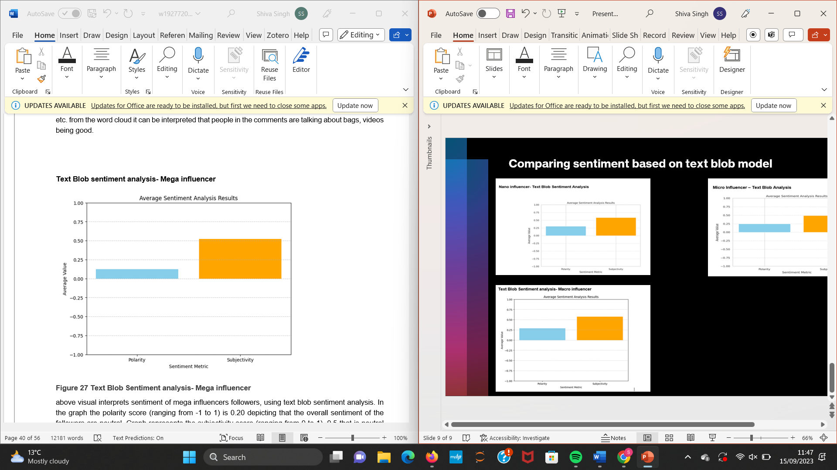
Comparing sentiment based on text blob model

Slide 10
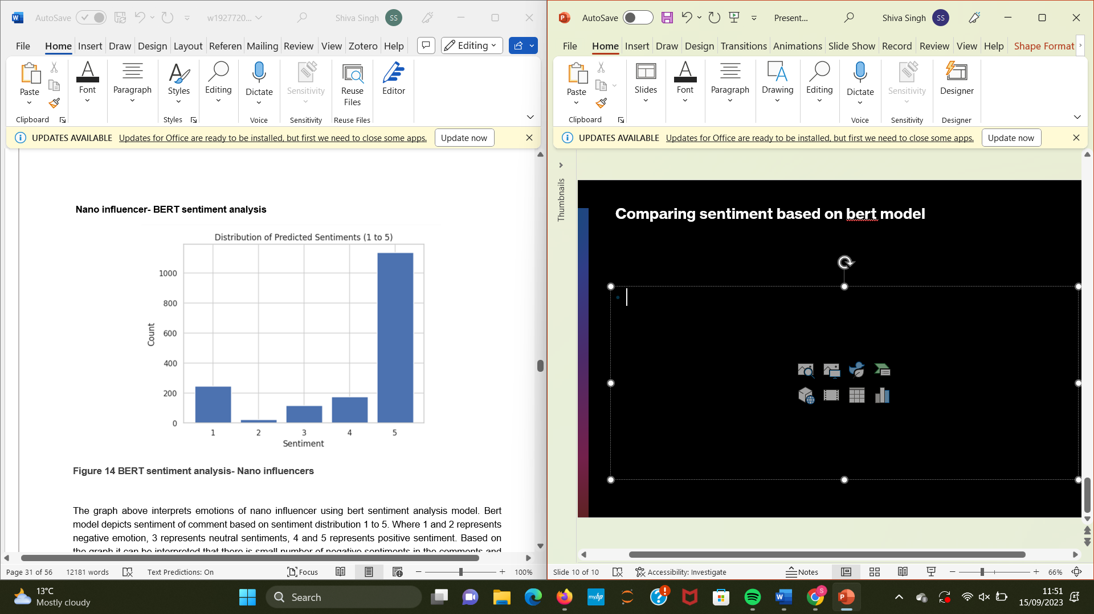
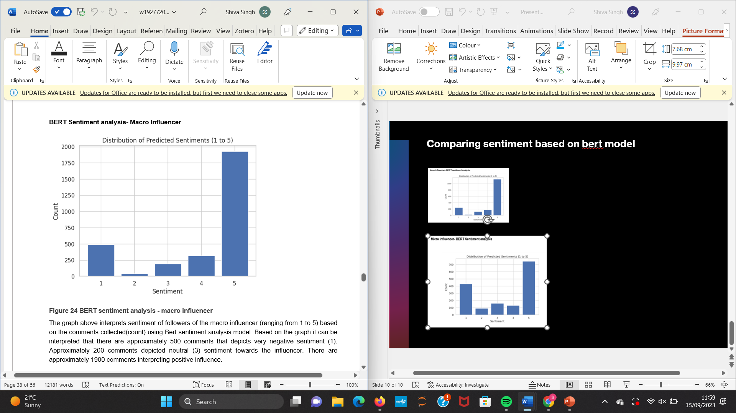
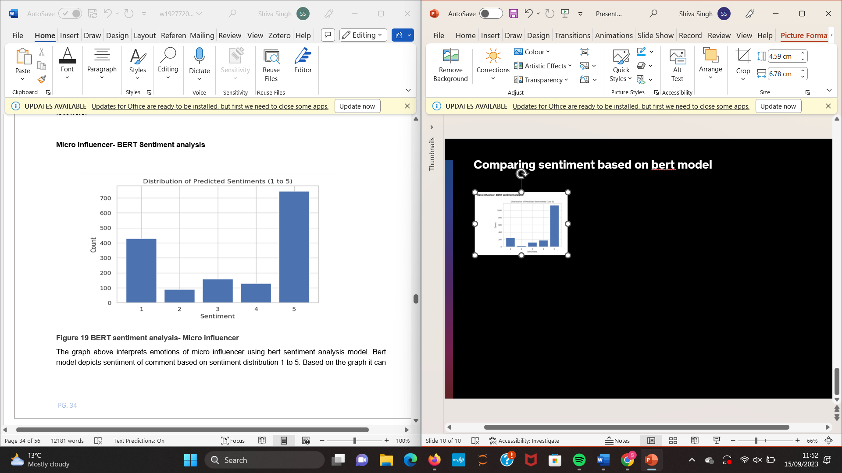
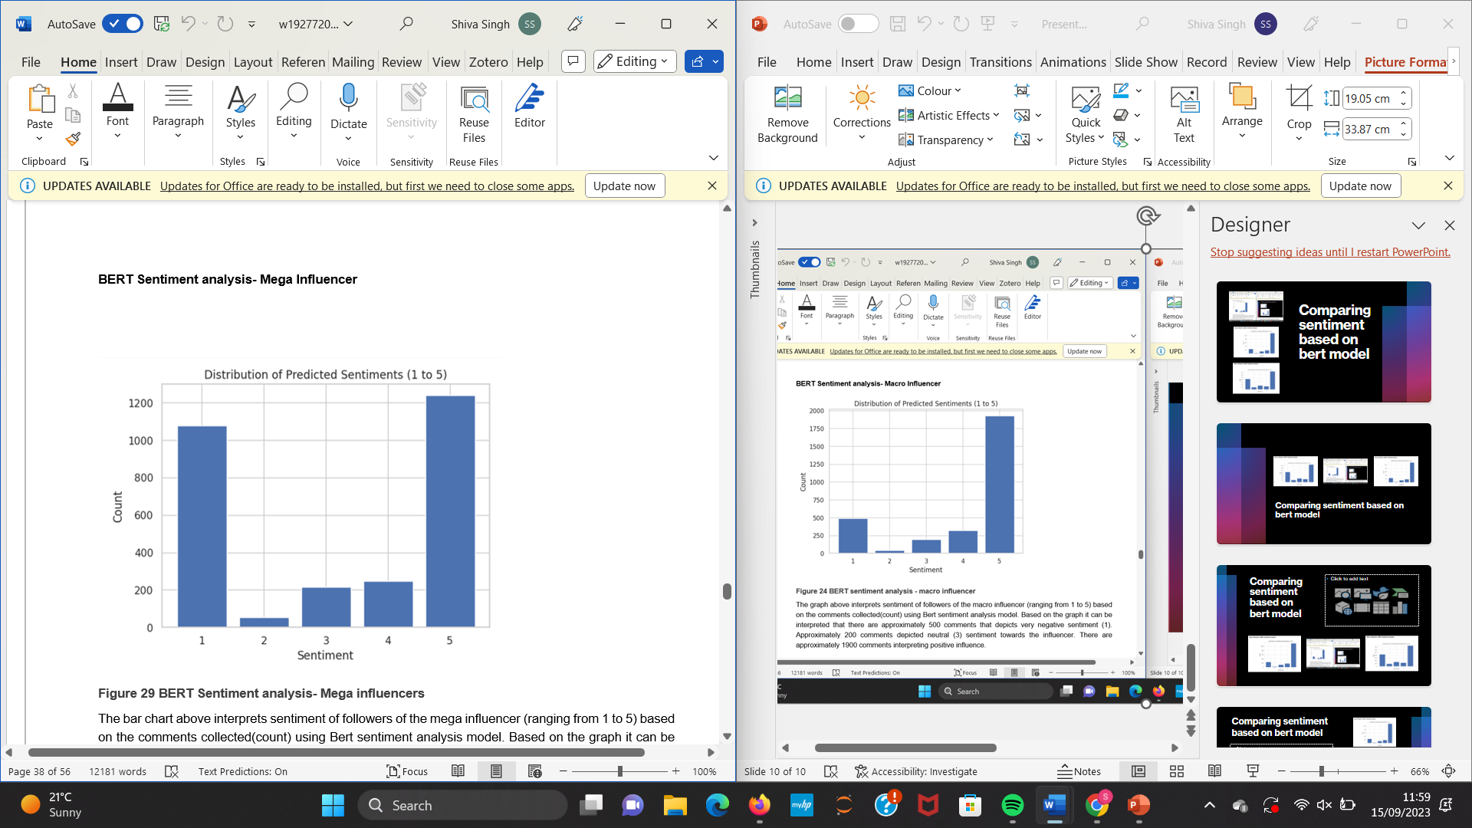
Comparing sentiment based on BERT model

